Slide 1
MSIT-423 Project —— Red Wine Quality
Team member: Fuyao Du
Erric Chen
Yusiqi Wang

Slide 2
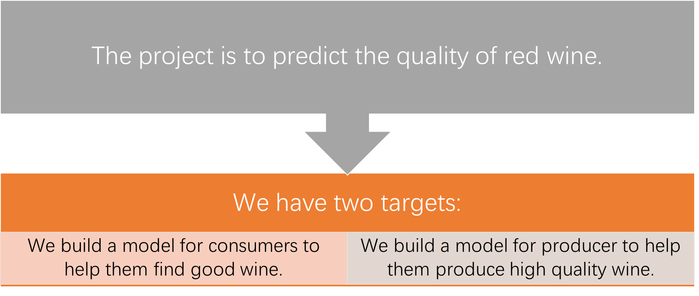
Project Description

Slide 3
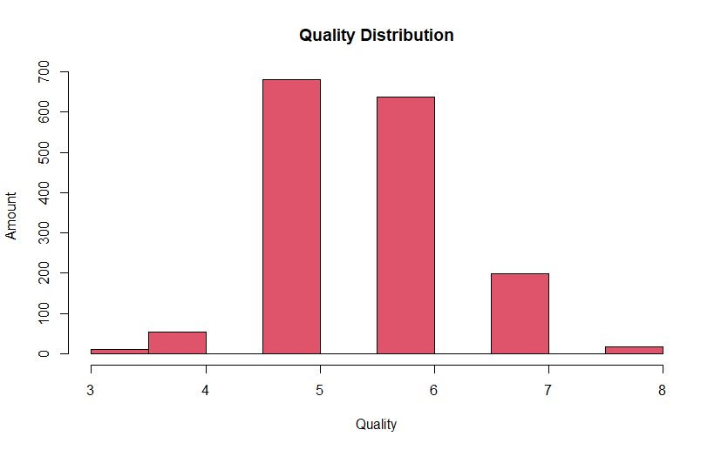
Not many cases of 3, 4, 8
Data Description
hist(red_wine$quality, xlab="Quality", ylab="Amount", col=34,main="Quality Distribution")

Slide 4
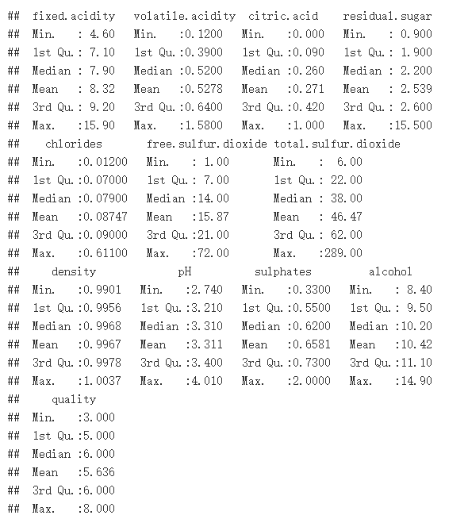
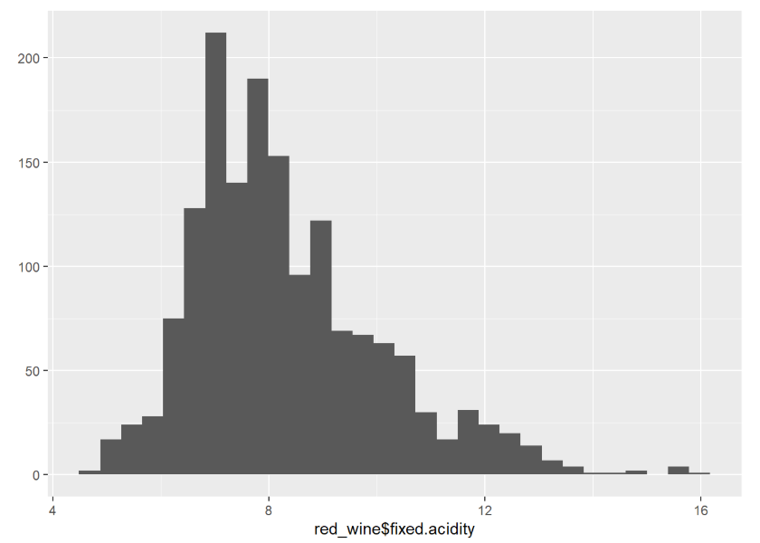
Summary(red_wine) >
#returned number is the same as the number of observations
nrow(na.omit(red_wine))
>
[1] 1599
#no missing value
(qplot(red_wine$fixed.acidity) -> fixed.acidity_distribution)

Slide 5
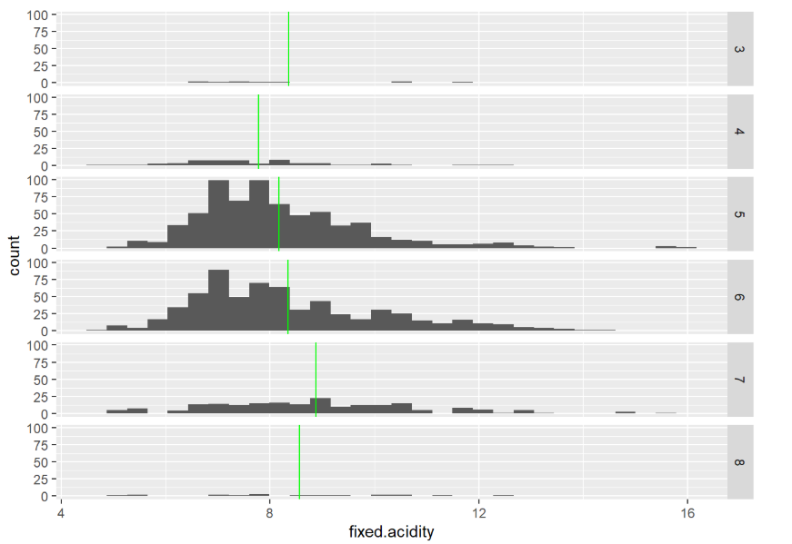
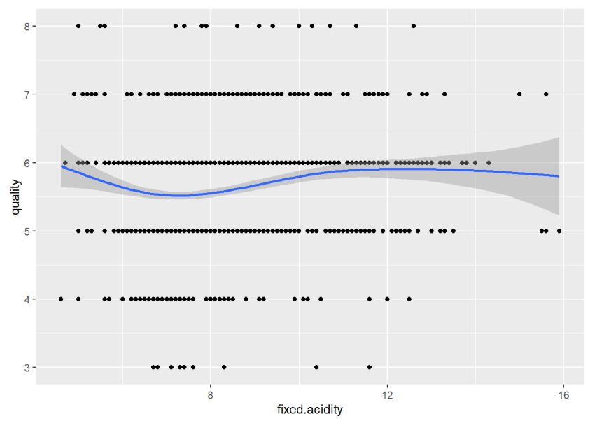
#average fixed acidity in different quality groups
ggplot(red_wine) +
geom_histogram(aes(x = fixed.acidity)) +
facet_grid(quality~.) +
geom_vline(data = fixed.acidity_quality,
mapping = aes(xintercept = mean_value),
col="green")
ggplot(red_wine, aes(y = quality, x = fixed.acidity)) +
geom_point() +
geom_smooth() +
labs(x="fixed.acidity", y="quality")

Slide 6
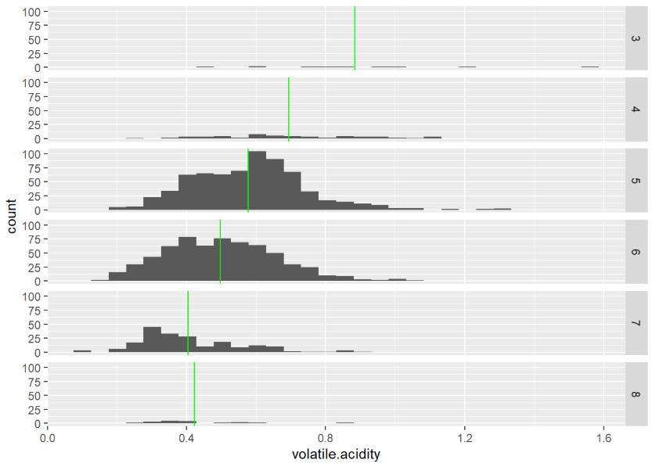
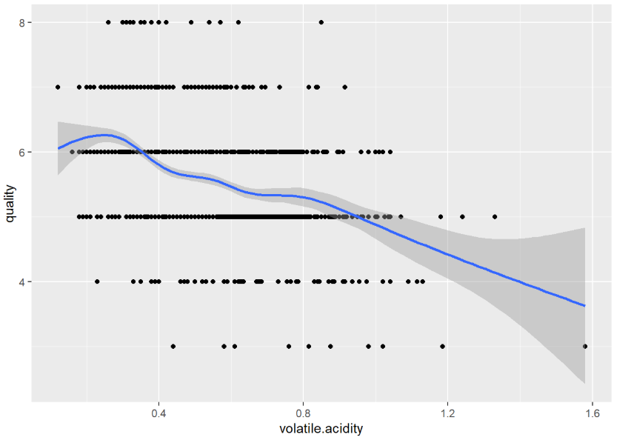
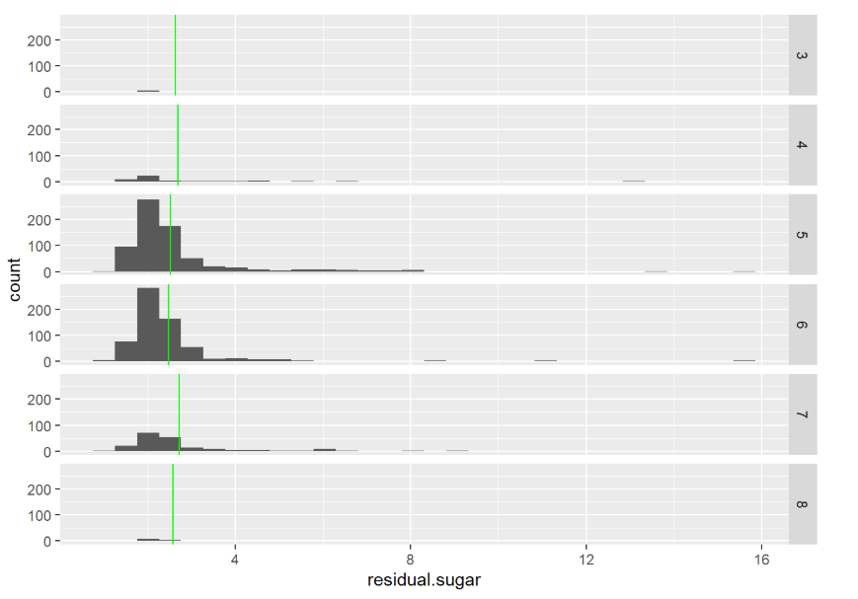
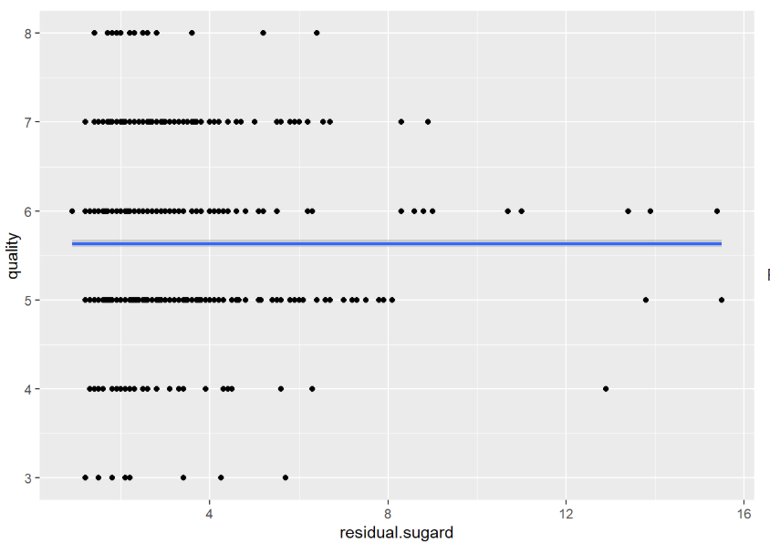

Slide 7
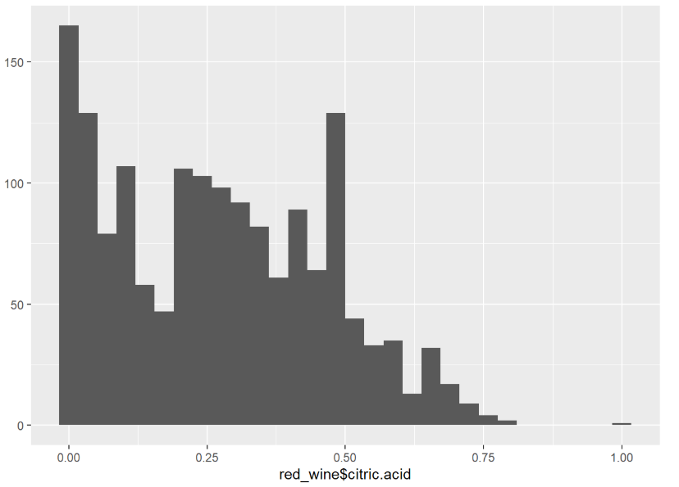
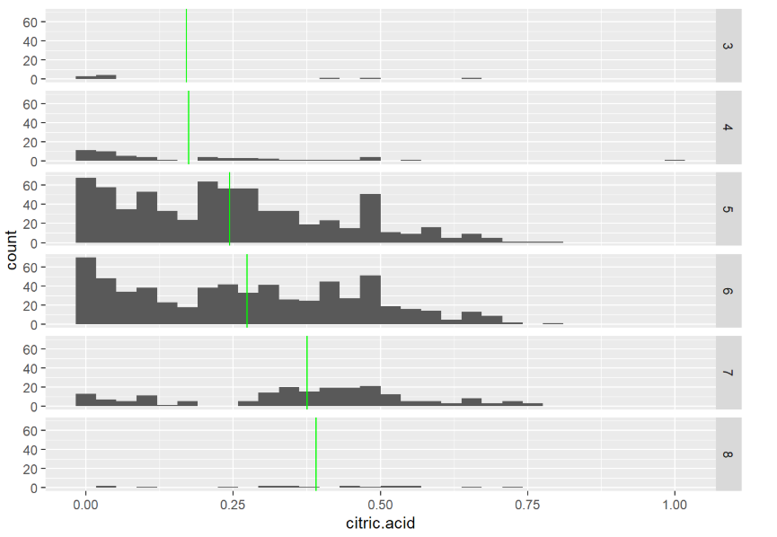
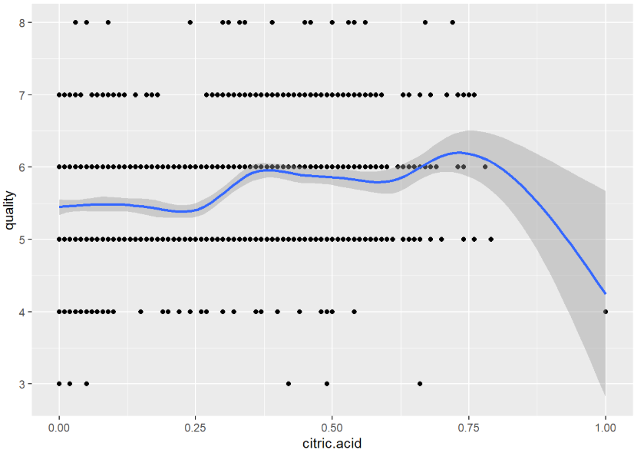
From the plots, we know that citric acid does not follow a normal distribution, and there is an outlier with citric acid = 1.00 and quality = 4. From the last plot, we infer that these two may have relationship

Slide 8
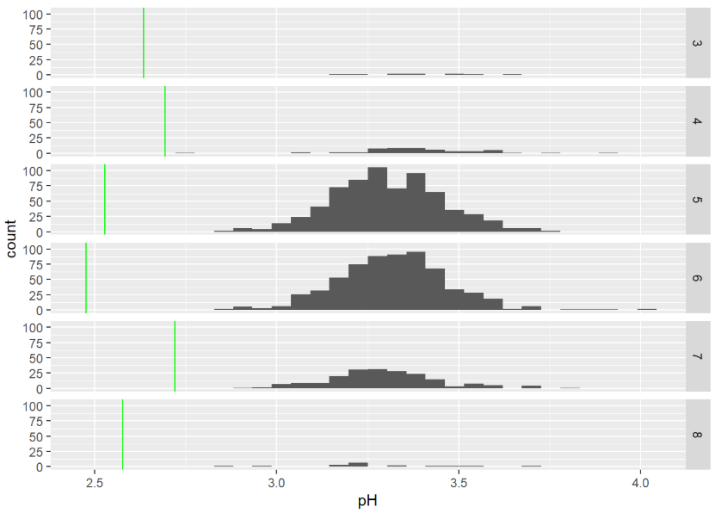
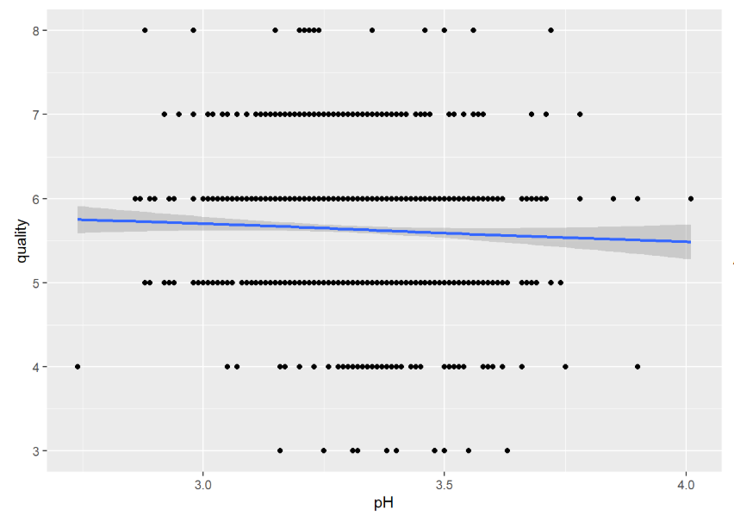
Although pH of red wine follows normal distribution from the last plot, we infer that pH influences quality very little

Slide 9
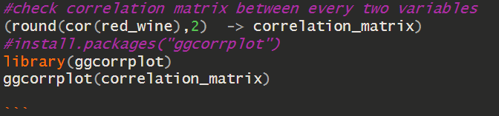
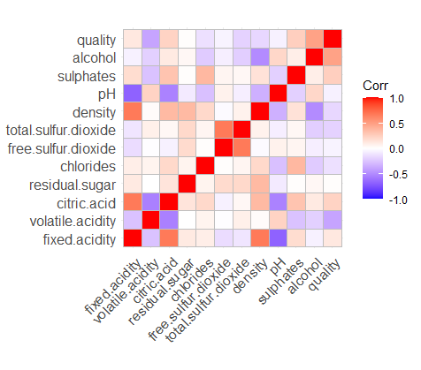
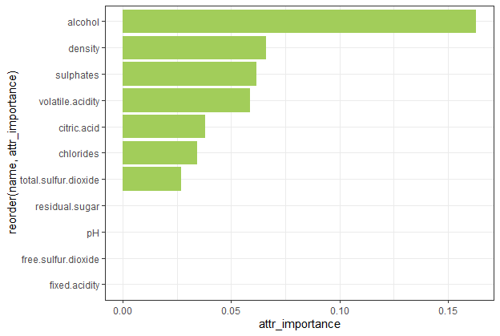
(information.gain(quality~., data = red_wine) -> information.gain_result)
information.gain_result %>%
mutate(name = row.names(information.gain_result)) -> information.gain_result
According to the last column of the matrix, we know that alcohol, volatile acidity, sulphates and citric acid have higher correlation value with quality
According to the results, we found that $pH$ give the least information to evaluation on quality, which is similar to the conclusion from visualization and correlation analysis

Slide 10
Model for Consumers
We take this target as a classification.
We will focus on the accuracy.
Explanation of the model is not important.
Methods:
KNN
Random Forest

Slide 11
KNN
The best K is 1
K | Accuracy
1 | 53.5%
3 | 49.5%
5 | 49%
7 | 51.88%
9 | 49.63%
11 | 48.75%

Slide 12
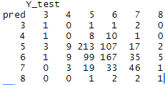
Confusion Matrix
The prediction is imbalanced.
KNN may not be a suitable method

Slide 13
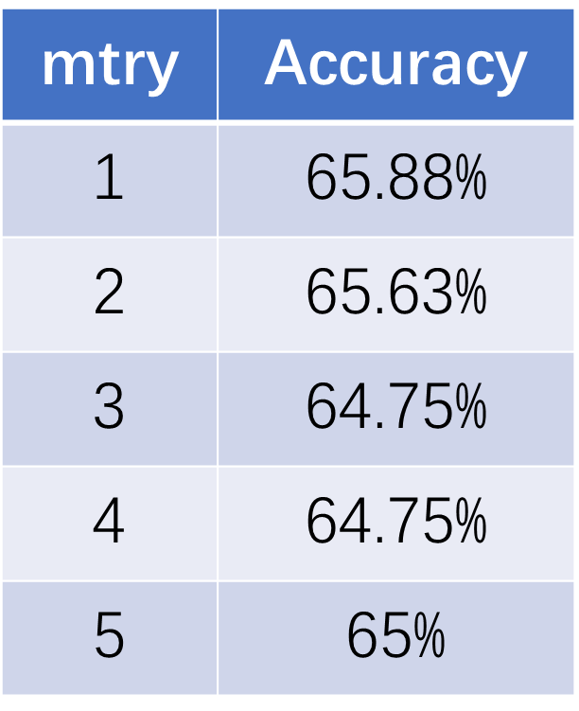
Random Forest
The result is similar.
Mtry =1 is the best

Slide 14
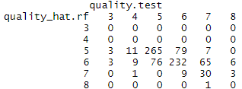
Confusion Matrix
The accuracy is better but the prediction is imbalanced
However, for our target is acceptable.

Slide 15
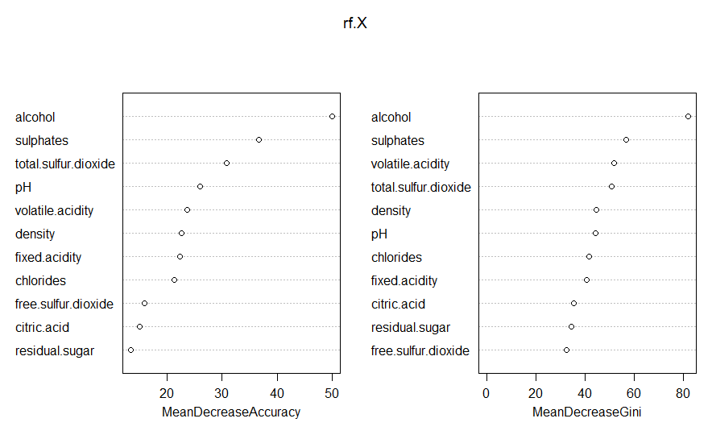
Random Forest
Alcohol, Sulphates and Total sulfur dioxide is significant.
This should be an inspiration for regression model.

Slide 16
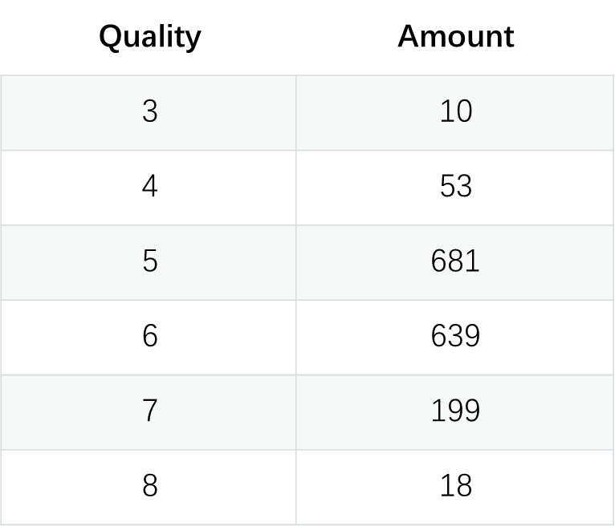
Why Classification is Imbalanced
The dataset is imbalanced

Slide 17
Model for Producers
We take this target as a regression problem.
We will focus more on the interpretation of the model.
Method:
Linear Regression
GAM

Slide 18
Linear Regression
After Stepwise：
Model: quality ~ volatile.acidity + chlorides + free.sulfur.dioxide + total.sulfur.dioxide + pH + sulphates + alcohol
MSE: 0.4122

Slide 19
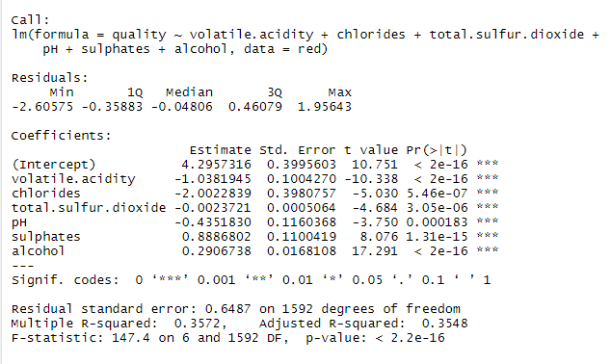
Linear Regression
Summary Stepwise：
every single feature is significant
negative
positive
model fits the data set well

Slide 20
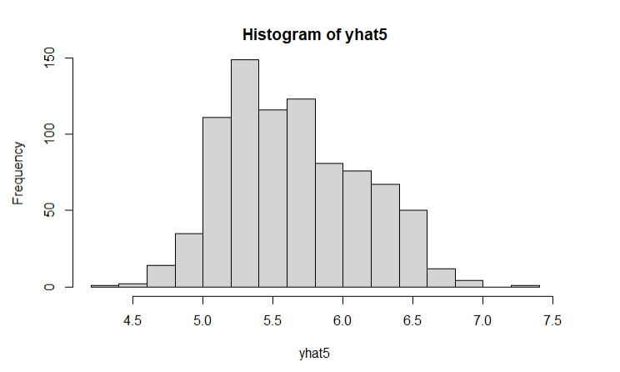
Hist of predict
The result of prediction follows normal distribution.
Similar distribution compared with the source data.

Slide 21
Finding
Alcohol, sulphates, fixed acidity and free sulfur dioxide has a positive effect on quality.
Critic acidity, volatile acidity, chlorides, total sulfur dioxide and density has negative effect on quality
The quality is most positive sensitive to sulphates
The quality is most negative sensitive to chlorides

Slide 22
GAM
The best GAM model without interaction:
Model: Quality ~ fixed.acidity + volatile.acidity + density + s(sulphates, 3) + alcohol
MSE: 0.4035

Slide 23
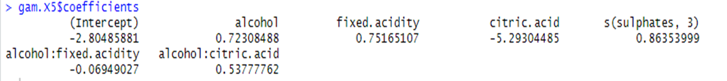
GAM
Considering Interaction:
Model: Quality ~ alcohol * fixed.acidity + alcohol * citric.acid + s(sulphates, 3)
MSE: 0.4404

Slide 24
Finding
Alcohol, sulphates, fixed acidity has a positive effect on quality.
Critic acidity, volatile acidity and density has negative effect on quality.
The fixed acidity’s positive effect will be reduced by higher amount of alcohol.
The critic acidity’s negative effect will be reduced by higher amount of alcohol.

Slide 25
Conclusion
Sulphates is the most significant feature.
The producer should increase the amount of Sulphates, Alcohol and fixed acidity.
The producer should reduce the amount of Critic acidity, volatile acidity and ensity

Slide 26
Thank You

